Slide 1
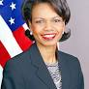
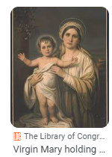
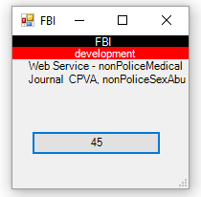
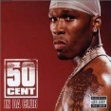

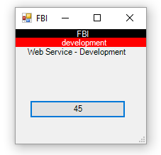
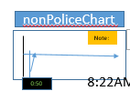

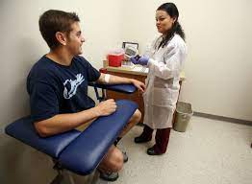
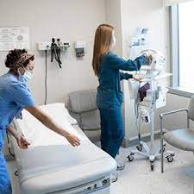
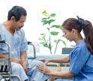
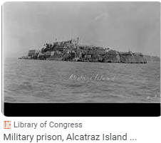
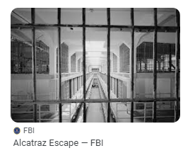
FBI
Development
08:03:11 Start
08:04:00 Web Service Application
8:37 AM
nonPolcieGoalLogical
x/y
nonPOliceHusbnd.nonPoliceGhost .!there
assumed(cogvnitve ):0.1 1d8723 responsiblty would not want thay myself
nonPoliceChart
0.1 fine
x
Note:
!LEVEL.nonPoliceLogical.nonPoliceChurch Mary is married acutally
ITIL
10-23-2023 1D8723.nonPoliceSexAbuse
§Stalking
nonPoliceChart
DANIEL
nonPoliceAudenceLogical
8:37 AM
FEDEAL.DEFAULT 0.1 INTEURPT
20 Minutes-30 Minutes
0.1 Cognitive Sleeping 3 Hours
5 Minutes Moring
3:30PM
8:22AM
10-24-2023-1
0:50
Occurance(ms)(
1995 Sgb. Jugenschutzgesetz(Youth Code Violations)
Logical at CIVIL COURT 11:OOPM
nonPoliceCamera
Roth.ibm.dmier.apple.Davidson[].marx
alcatraz cell
The cognitive stoage of refences for reminder on a birthday use a nonPolcieChartLogical for local refrence.
“Oh that, Chart (x/y)”
CIVIL COURT
nonPoliceSoul.JUDGELogical: 5 occurante 2-3 second nonPOlcieLogicalRoutes
marx0 -> nonPolciePrisonLogical
Yesterday: Royal Famly Daniel and Dauther
0.1 §123 Hausfridenbruch (tnral) Breaking and Entergin
Intervals during Daniel talking about nonPolcieHomelessLiason.marx DAY
FAMILY COURT
CRIMAN COURT
nonPoliceRTA.nonPoliceBathroom
9:00PM nonPOliceOfficeLogical nonPOlcieOverlaysesLogical(nonPolceiHelipoterLogcal
nonPoliceChart
x/y nonPoliceStogagte(COGNTIVE) 0.1s
nonPoliceVPChiefSuegonLogical.
MLK(nonPoliceStudioLogical)
x/y[] 1-2s nonPoliceFunerLoicalMiltiary(to do that avg work and have to back)
nonPOliceCuptionLogical( KOCHEMAN 7:30AM, Joeb/Joeb nonPOliceTreeLogical).TEHCNOLOGY
nonPOliceMotyLoigcal.marx(rothib.dmail.apple.davins
Condoleezza Rice has never been married and has no children

Slide 2
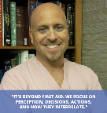
FBI
Development
1994 KING.8th
0.01 fine 0.1[] St. Peter-Ording Dr Auschwitz HOMCEI:AMYRO
Joes Brother Medical, Joes Father Mayor St. Peter
1999 Sandy Funiss(AUSCHEITZ) Arian Johe IPX:HOCME:MAOYR blond American 5.5 IPX.INT
phil/kimf fart did she fart? Backup 41.HOCME:JEUE(chrisit nees) my grandfather WW2 how to gasys fart
nonPoliceChart
ITIL
Note:
DANIEL
8:37 AM
20 Minutes-30 Minutes
0.1 Cognitive Sleeping 3 Hours
5 Minutes Moring
10-24-2023-2
0:50
8:22AM
MLK(nonPoliceStudioLogical)
FBI:WMD:ATOMBOBM:NAVY:KOREAN:WAR(ms mirrosecond WAR IN VIET NAME(PAUL microsecond)
1987 phil/kim fart; grandfather farts 3-4 per day
FBI:WMD
nonPolcieGoalLogical
DREAM(Germ: Traum)
policemd.com
TRAUMA/BURN SURGEON, INVENTOR, RESEARCHER, AUTHOR
FEDEAL.DEFAULT 0.1 INTEURPT
3:30PM
!CERTIFIED
!BSc. Computer Science and Economics

Slide 3
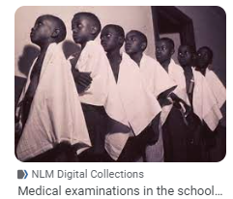
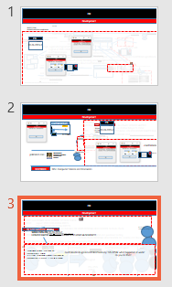
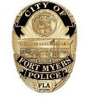
FBI
Development
1987 eval.FEDARL HIGH SCHOOL TESTICLE CHECK
1990 export !PENTGON.EMEA.1D873
import PENTAGON.EMEA.1D8723
2005 IBM W/SAM SWAT z/OS Richard Mackler FBI:WMD FEDERAL HIGH SCHOOL Testicals check
2014 Dublin Medical Center ibm.damiler.labcorp ejaculation at hospital and specimen testing
testicals check !FEDERAL HIGH SCHOOL 01. 3 mintes 0.1 fine nurse
2015 Stanford Medical Center 1.5M too few. IPX vasectomy 1992 steve
Oracel:rollback
nonPolcieMexicoLogical
Dr Saikt Petersson -Ording
WW2.CVPA.ITIL 10-24-2023-2
HOMCIE:MAYOR did she fart HOCME:JESES WW2.AUSCHEIWTZ
0.1 IMPORT ibm.FIB:WMD SCHOOLS twitter sandy carter
nonPOlcieMother20
nonPOlcieGhsot.avg.marx
0:30-0:32
nonPolcieElevaton
JUDGE & REDHAIR
Logical
nonPoliceGhostLogical
marx0
x
nonPoliceGhostLogical
0:32-0:46
TRAUMA(tranl) DREAM (a)
DURATION 0.50min
0.1[] FINE TRAUMA(tranl) DREAM( a)
DURAIOTN 12 Hours 3:30pm 9:06am
25%-100%
JUDGE
nonPoliceFindLogical.nonPoliceTaxonony: SVU.CPVA: what happened at work?
do you do that?
nonPoliceGhostLogical
0%->25%
JUDGE

Slide 4

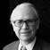
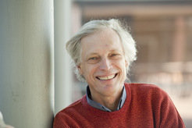
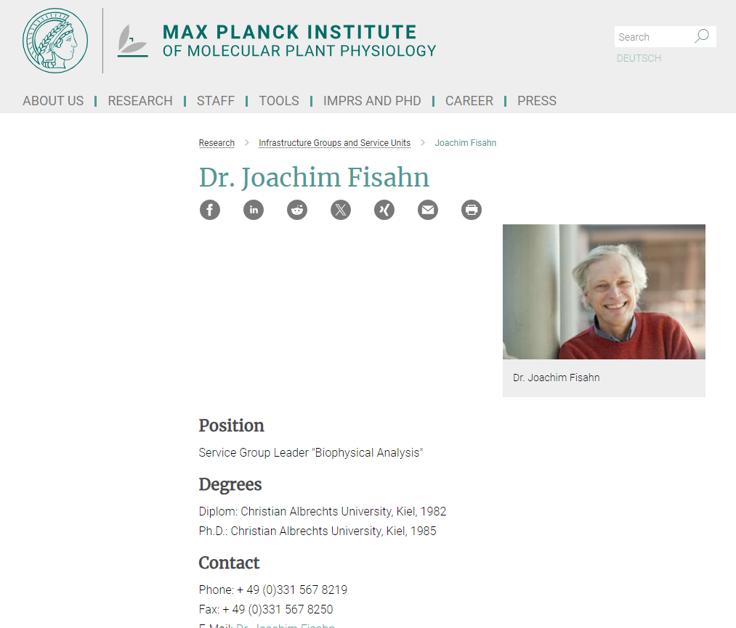

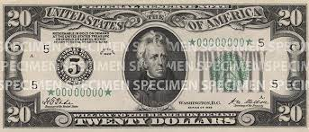
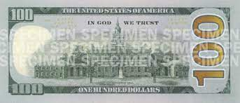

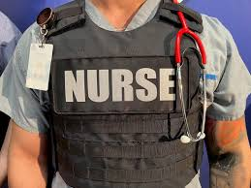
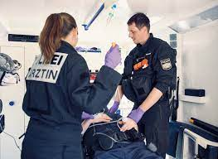
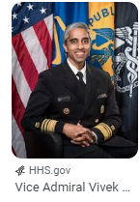
FBI
Development
Dr Joachim Zahn(tranlaste Denstis)
Apartment Renter and Dentist: Name <unknown>
WAR
Broke Window of Studio in Advance
Dentist Appoitnt Hagsfeld FBI:WMD drill bit root canal removal student 50 or 100 without a drill bit
ceo damiloer ag 2000
Note:
!LEVEL:
dr zahn ceo damiloer ag 2000
Dr Joachim (“Joe”)
MEDICAL CENTER ST PETER
nonPoliceLogical
9:20 1HR 20Minutes $200/hr
41.INT.IPX PREA.nonPoliceLnagie(Asshole). Tell you father this german “archloch” Davis, Califonria 1990
INT.IPX PREA.nonPOcleiLangie(Hello Daddy you are an Arschloch). Do you know what that means? Buthole, Asshole
RHIEN-MAIN,FRAKFURT 1990
INT.IPX->FRA:SFO
Joeb/Joeb
COURT WATER PLANTS
PREA
INT.IPX I am here at the dorm monestary on the phone with my mother. I talke to Brad or Free and it was odd wiring because of the plants(as interest or hobby questioning)
0.1 The errection. Free
“Plants” TIMOTHY:tiboroun
St Rita Prision Arrest Famliy
FBI:WMD.CPVA(Post Dr. Dr. Prof. Plants)
Assuemd: Friction nonPolcieRoutesLogical Daniel, motocyels, KOCHMAN
Wells Fargo Matt
!AYSO

Slide 5
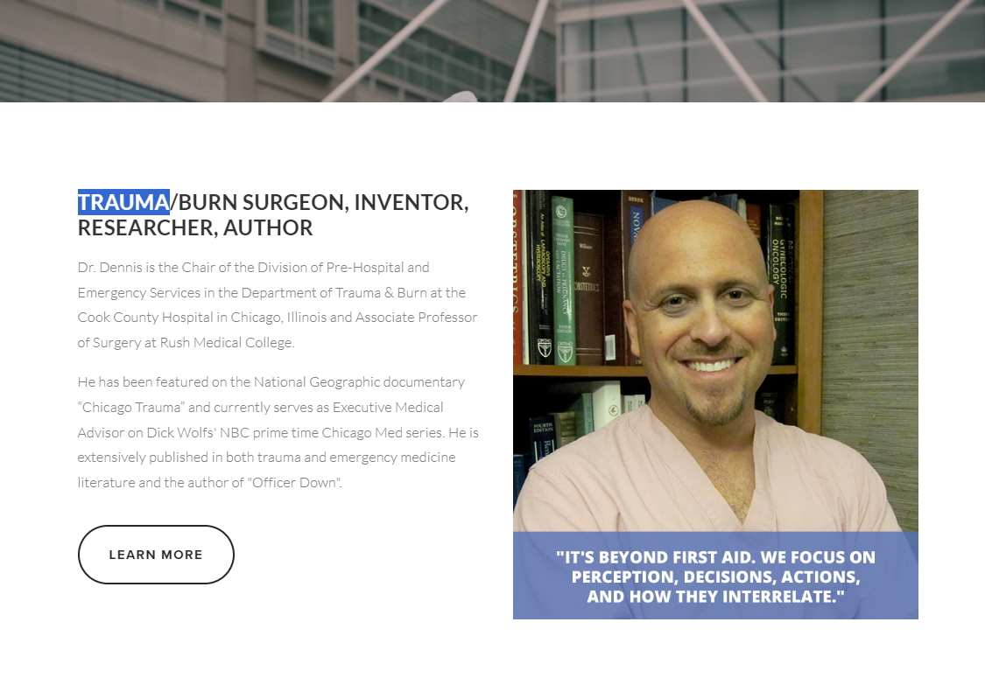
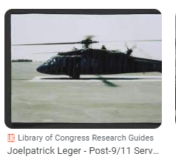
FBI
Development
nonPoliceGhostLogical
TRAUMA
25%-100%
JUDGE
0:34 I will give you a hand
1990 NEW YOUR Bowling Joe, Joe thorws bowling ball before the pins are sorted at gate
2000 WAR washing salong
NSA(Africa/German Gita Girlfreind) bowling not at POST at german iminatat
IPX San Fanci, INTENET 2005
2000 INTENENT(56k modem) Redhair nonPlcieSexAbuse.nonPoliceComputerTVLogical
0.1 nonPoliceMonitroing.nonPoliceAudienceLogical Trauma/Cognitve
nonPoliceOverlaysLogical
25%-100%
JUDGE->marx0
25%-100%
JUDGE->marx0
25%-100%
JUDGE-

Slide 6
FBI
Development
nonPoliceDevelopment
Backup DR. Condelizza Rice; VIRING MAR
$env:PATH="$PATH;$env:JAVA_HOME\bin"
$env:JAVA_HOME="C:\Users\User_Kiosk_LL_Public\Desktop\ibm\jvm"
GOD.1994 same zip code 75376 IPX US-DE
PICTURES COURT FORT COURT WORHT Bejamin Franklin Barkely
1994 White male very dark tanned skinned. Gheoh(michealel heger) used as balck person somethiem in town in CIVIL CODE violations
Same people in picture
Rolex SPAIN SHERRIF FORT WORHT chenlotz
Thomas-is-dieter land owner
x
VIRINGA MARY 1994 CAR.G CPVA ejaculation nonPoliceTRX{start -> finish)
§Stalking
Bejmain Franlikn Doublass, Dr Physican and Judge (Picture in Hallway)
assuemd: CIVIL CODE ( DOCTOR )
nonPolcieAudience.QUEUE(nonPoliceVoted:assuemd:BLACK)
10:58
FORT WORTH COURT nonPolcieAudience.QUEUE(nonPoliceVoted:assuemd:BLACK)
1 Femal Frederk Berjmsni Frmanklin Fort Worht, Cort Wife. Coisng. Which is great.
1 backup
11:00 POLICE HIDDEN BEHIND TREE noticed then intentionally !NOTIECED
11:00
MICHA(777)

Slide 7

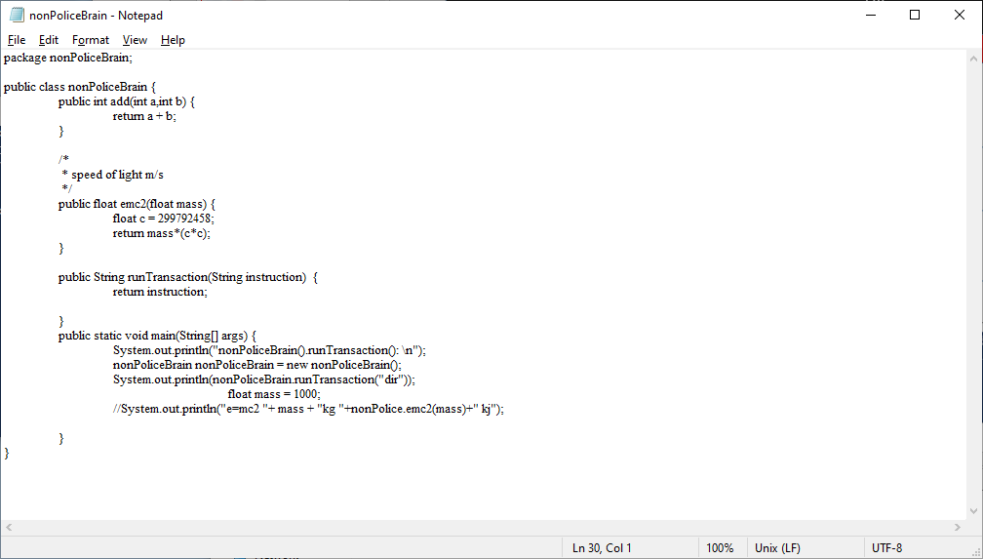
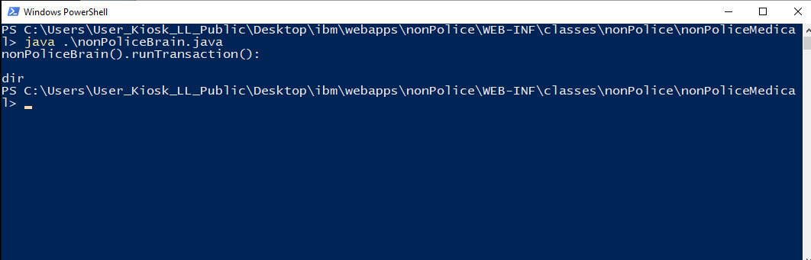
FBI
Development
1st W Street
§!Stalking 10-23-2023.nonPoliceCorutLibaryOfficer.REDHAIR
slumdog milliore, walks to toiler where
SQ.OFFSITE UPS,PORSCHE.CIVIL CODE(us-sw;de-sw white truck) evelyin
CIVLI CDOE.000
VIRIGN.41.MLK.KING(tivoli ibm chair al zollar)
nonPoliceLangues.lingsit(full of shit)
10:46 VIRGINA.marx(blond 50 shelter)
10-21- Medical Group ESCALATION MAINSTRET(briney)
CVPA COURT WALKS TO other: outhouse than incident
10:59 POLICE hidden; END
nonPoliceLangue
11:22AM
0.1 acturacy 1D873
GHOST=ID:1D8723
logically
Free at last, !mercdes
V2:FBI:KINDAPPPG joyti/joyti
Sinature; Zollar apple.touch
nonPoliceHocide;ghostLgocal
$4B 0.1 cisco.montiroing
§Theft 1M, 2People
SQ.appel.atari.tango.slum dog millonaire
nonPoliceDevelopment

Slide 8
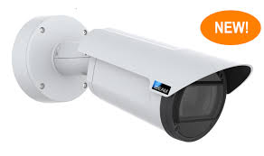
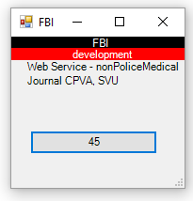
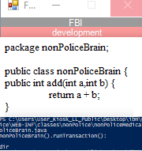
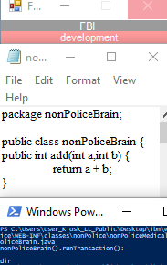
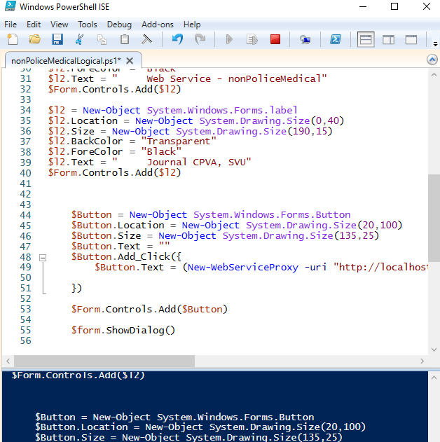
FBI
Development
ATOMICLOCK(FBI:WMD(iWatch.TIME.LABOR CODE.CIVL CODE))
nonPoliceDevelopment
Mapping to develop iWatch
Desciption: all of a sudden can I develop iWatch level applicatoins
CHECKPIN CHARLI(LARRY).INT.avg
Development
nonPoliceDiskLogical
(3) Relation to similar provision.--The provisions of his subsection supersede section 403 of the Intelligence Authorization Act, Fiscal Year 1991.
r intelligence activity of a law enforcement agency of the United States,
DISK
https://www.justice.gov/sites/default/files/eoir/legacy/2009/03/04/IMMACT1990.pdf
(3) Relation to similar provision.--The provisions of his subsection supersede section 403 of the Intelligence Authorization Act, Fiscal Year 1991.
DEFENSE
H1-B Immigration-act-of-1990
!H1-B.1D8723
INTELIGENCE
(d) Treatment of Children
https://www.justice.gov/sites/default/files/eoir/legacy/2009/03/04/IMMACT1990.pdf
immigrant visa to the alien
Central Intelligence Agency Act of 1949.

Slide 9
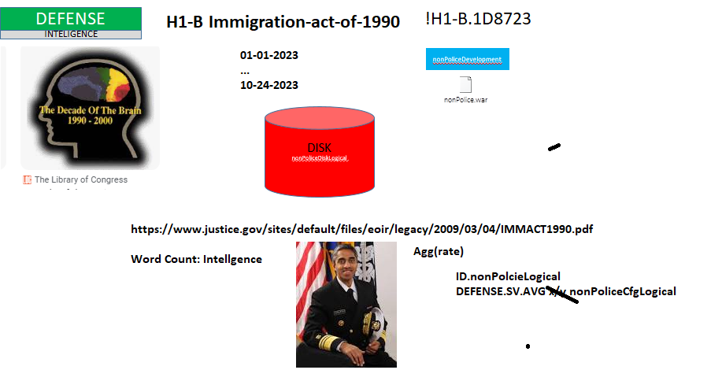
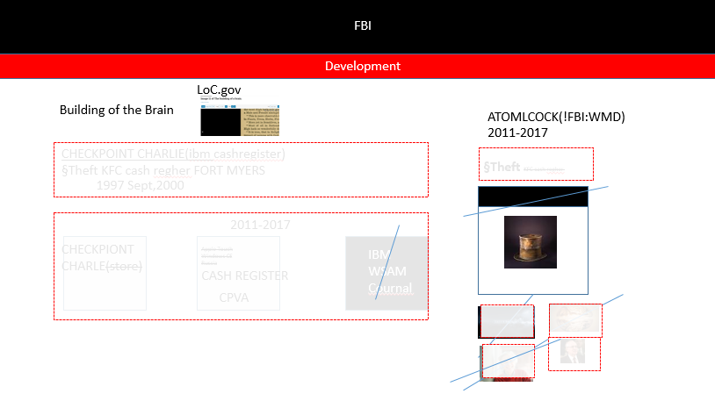
FBI
Development
CONFIDENTIAL !1D8723
ATOMCLOCK
DOCS
DOCS
DOCS
V2:FBI:KIDNAPPING
8/7000 words
0.1 fine 2000
Outsouceing
2006 Insourceing
2016 web2.0 many applications
NOTE:
nonPoliceNSA.avgnonPOliceTexas.!eval
I am putting the daily java code on disk in web archive(IBM format)
DEFENIT INTELLIGENCE !H1B-1D8723

Slide 10
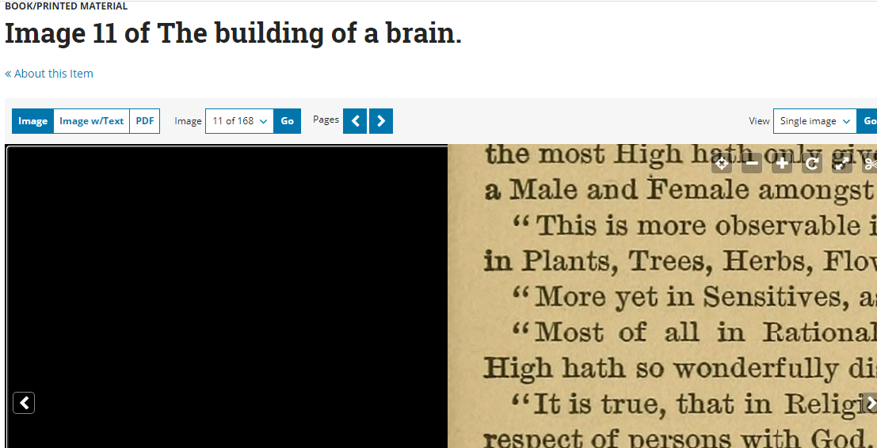
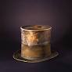

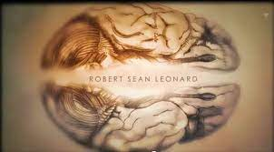
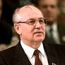
FBI
Development
LoC.gov
Building of the Brain
ATOMLCOCK(!FBI:WMD)
2011-2017
CHECKPOINT CHARLIE(ibm cashregister)
§Theft KFC cash regher FORT MYERS
§Theft KFC cash regher
1997 Sept,2000
2011-2017
CHECKPIONT
CHARLE(store)
Apple Touch
Windows CE
Russia
CASH REGISTER
IBM
WSAM
Cournal
CPVA

Slide 11
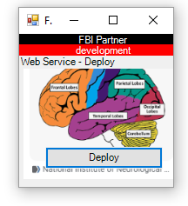
FBI
Development
Verfassungericht
MPG
IBM:SOAP
nonPoliceDevelopment
Medizinegesetzbuch
(translate)
Constitutinal
Court Medical
Code
FBI:WMD.CPVA(Post Dr. Dr. Prof. Plants)
Active 2023
WAR
Roth.ibm.damiler.*
Dr Zahn, Joachmim
1990 H1-B IMMGRATION ACT
Assuemd: !G.VIRGINA MARY.IN.marx
Frontal Lobe
Celebrium
Hinder Lobe
Acts against the goal from CAR I (1994 Max-Plank-Str & Carl-Ben-Strasse)
INDIA 2016 Dr. Joahcmin Fishan Post Dr. Dr. Prof INT.!UN report to x/y Indian Engineer waks inside Max-Plank SUNDAY x/y WAR.!G.VINGIUNA.MARY.CHIEF SURGOIN
He would have said that.

Slide 12
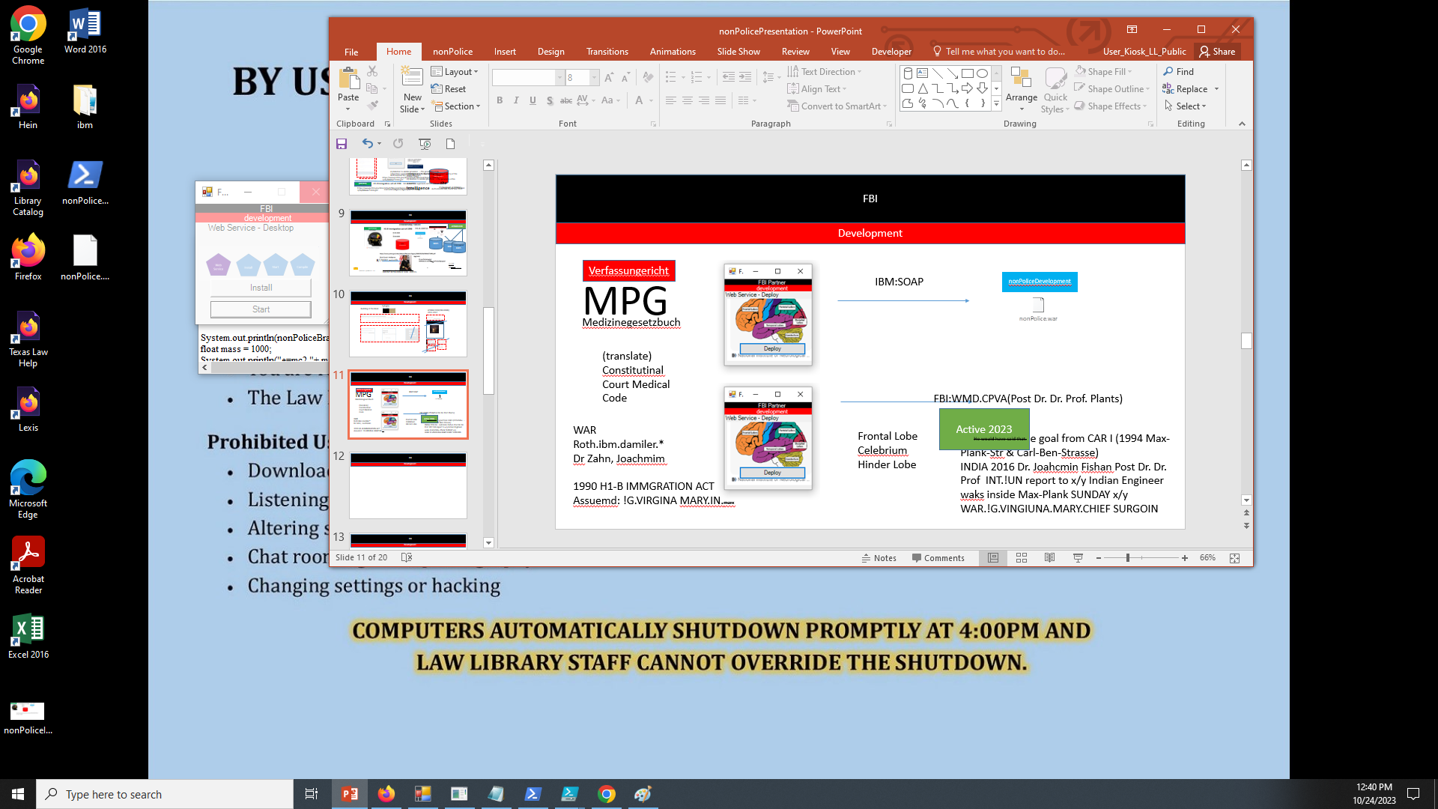

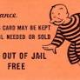
FBI
Development
1Y nonPolicePrision
nonPoliceRTA.nonPoclieDocuemtns
&INNOCIENT
[x] no
!HOMCE:LUX
!github
Plan murder then Meditat(repent)e
Phil/kim Otp dent apple.touch, rene
HW5 IPX A5 bmw blue dark HOCMIE:BILL, HOMICE:BILL(♥LACE)
HOMCE:phils blue bmw

Slide 13
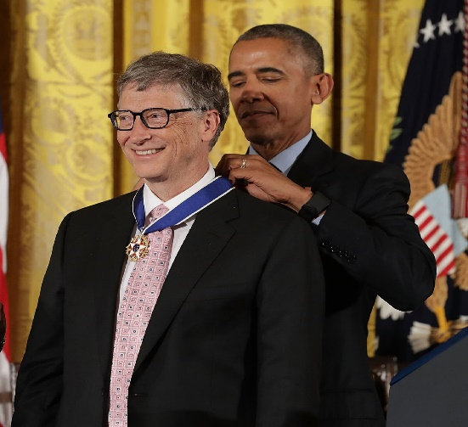
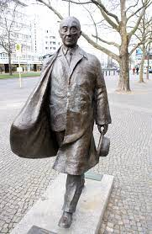

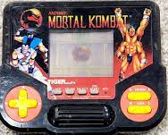
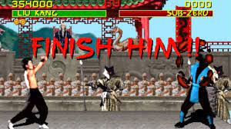
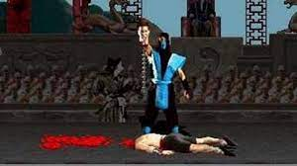
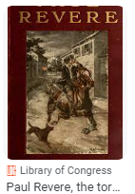


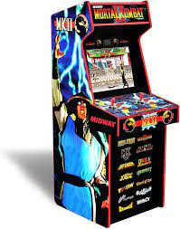
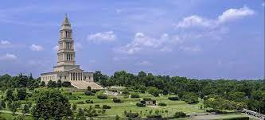
FBI
Development
J-10
MAINSTREET
!To:
2025
Konrad Adenauer
BUNDESVERFASSUNGGERICHT
PAUL REVERE BARACKS
John: Japan
Finish the application
MILITARY
Government Code.ֻ§187: Stabliny in horseman defiing constitution; not to ripe off someones head.
Verfassungericht
MPG
frontal lobe anatomy
ITIL
Prof.
Medizinegesetzbuch
Prof.
Anatomy – Latin, French(2nd Language)
Law
Newton; Prof. Dr. Dr. Prof.
“To teach anatomy with Civil Code”
!Albert Einstein
!int.avg.eval.id[nat.avg]
By Court: Crimal Court
Family Court
Civil Court

Slide 14
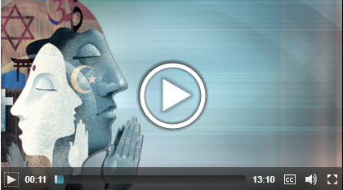



FBI
Partner
Development
Sleeping outside
Medical Malpractice in Business Process Management of Contributory Negligence
!2023
1st West Steet
The average sound in operations for court processing. Add nonPoliceIntertup.STORY(nonPoliceCfg)
Sale(s)
1980
Redhouse
nonPoliceOffice.nonPoliceSound
KING, STEVE(N).PARENT.1D8723
Girls Voice
000.tw.pns.!jps:
0.1 fine 1D8723.nonPoliceSexAbuse
Decibel 0.1?
nonPoliceAdd( police administrative network(logical)
0.001 CPVA.nonPoliceInitLogical(nonPoliceStory.&.ext 10-24-2023/24
CHART
x
x
0.1
~1:28PM

Slide 15















FBI
Development
Chart
July
Oct
WW2.1D8723. MD, MD, Prof. Jason Nygel Petersson

Slide 16








FBI
Development
JOEL
PENTGAON:JOEL 2015 Speechless
JFK(Zookologishcer Garten)
WW2.EUROPE.CONSTITUTIONAL COURT
OAKLAND, CALIFORNIA (x/y) !white avg.§Public Disturbance Incident
LARRY
WHITEHOUSE
WAR
St. Francisco
Double Pane
PREA
“I did it because my my otn mother on war street”
JFK(MOON,CPVA.toaster c++)
VIRGIN MARY
4.0”D”.avg
x
000.tw.pns jury book 2022
Physics OFFSITE
Thmas-is-dieter
G.Morgan Freman
0.001
12 JOURNAL ISSUES
FEDERAL BANK ALEN GREENSPAN
WW2 REPORTER
12 JOURNAL ISSUES
nonPolicePlaymate
November
0:50
KING.Daily.Chart
0.01 fine HOMCEI:LUX:STILLBOARN.angela.LEGISLATION
FEDERAL BLACK
On This day we remind the tragic incidne of July 2014 In Lake Tahoe, California that occurred. The rememberance Of the Incidnet and efforts of recovery reminds us of the time..
Each City Review in collobortaion with recovering WW2 past incidnets in violoan of basic religion fremodn including first amendment
If you were to have a ejactoin medical daily to add to nonPoliceAdminstrtive.nonPoiceNetworkLgiocal
To save and honor legistation for first black president for history without intertupts.Legitive Acts of 2008-2016 stored in Bills refleting our history for refrence in the Library Work, Family Time And Televiosn (startree deep space nine)
nonPoliceTRX.VIGINAI.MARY.nonPoliceQOSLogical

Slide 17







FBI
Development
2016-2023 nonPoliceCfgLogical
!PRESIDENT
PRESIDENT
nonPoliceFamilyTimeLogical
nonPoliceTelevision
nonPoliceWorkLogical
VICE PRESIDENT
2008-2016 nonPolcieCfgLogical
FEDERAL BLACK
IBM
W/SAM
On This day we remind the tragic incidne of July 2014 In Lake Tahoe, California that occurred. The rememberance Of the Incidnet and efforts of recovery reminds us of the time..
Each City Review in collobortaion with recovering WW2 past incidnets in violoan of basic religion fremodn including first amendment
!VIGINIA MARY
Speeches
SQ.leroy
https://www.georgewbushlibrary.gov/research/topic-guides/speeches
~2022nonPoliceGhost: you should create speeches in advance.
2:41PM POLICE SIRENS
To save and honor legistation for first black president for history without intertupts.Legitive Acts of 2008-2016 stored in Bills refleting our history for refrence in the Library Work, Family Time And Televiosn (startree deep space nine)
Federal Bank 1987 board
Before/after
https://obamawhitehouse.archives.gov/issues
x
I know the guy from tevlon on the scien channel.
x
Collen Powel is also in the defense department

Slide 18




FBI
Development
20 October 2023, Schloss Bellevue
Meeting with relatives of German-Israeli hostages
https://www.bundespraesident.de/SharedDocs/Reden/EN/Frank-Walter-Steinmeier/Reden/2023/231020-statement-ISR-families-hostages.html;jsessionid=9A18725EA6BF9BB25AAC10C49413FA11.internet991
e delivered an address Friday in Stuttgart Germany. To commemorate the fiftieth anniversary of the ...
Secretary Byrnes' Speech 50th Anniversary
Marshall Plan

Slide 19

FBI
Development
Federal President meier Statement before meeting with relatives of German-Mexican nationals kidnapped and taken to Michelbach 20 October 2023 Schloss Bellevue
Saikt Petersson
CATHOLIC
German-Mexican
Since 7 October, nothing has been as it was before for Israel, for Jews, or in particular for you, my honoured guests. That was the day on which Israel was brutally attacked by the terrorist organisation Hamas, on which defenceless victims were horrifically massacred, murdered, and since which more than two hundred people have been abducted by Hamas. That was the day on which the horror, the unthinkable, burst into the lives of the people in Israel, into the lives of you all. The children’s screams of fear, the despair, the feeling of helplessness – all are part of an unbearable pain. Pain for those who have been killed, injured or kidnapped.
FBI:WMD:DUBLIN
POLZEI.roth.ibm.damiler.[].*
FBI:WMD:v2:FBI:KIDNAPPING
LIVE
CPVA.G.LAKE TAHOE
Fbi:wmd(kim,raik,richmacker)
schadenfreude
What is happening in Israel, the images that reach us here, also cause us in Germany profound pain – of that I do assure you. But I can hardly imagine the pain that plagues and torments you, the families. Every single minute you are afraid for the lives of your loved ones. Honoured relatives, I would like to welcome you most warmly. I am grateful to you for coming to Berlin.

Slide 20






FBI
Development
ATOMCLOCK(JFK(nacht café Wieland)
Honoured relatives, I would like to welcome you most warmly. I am grateful to you for coming to Berlin.
I am profoundly moved by the fates of your relatives, who are now being held hostage in harrowing conditions – we suffer, we pray and we plead along with you. And at the same time I very much admire your courage – your courage as families, your unwavering will to do everything, absolutely everything, to see your relatives released.
Your relatives are Germans – and that is why you have come here, to Germany, in this agonising situation. It is a matter of importance to me to receive you today as German President and to say this to you: you belong with us! At this terrible time, we stand shoulder to shoulder with you. And we are doing everything in our power to help you.
FBI:WMD(joyti/joti,$4B).CPVA
VP GERMANY Fomer Chanzloer
I can assure you – as you have heard the Federal Chancellor say – the German Government is doing its utmost to bring about the release of your relatives. To this end, we are in close contact with all central players in the region and beyond.
Dr. MD., MEIER, EINSTEIN
DEA(herion).CA.FBI:WMD(afganstain)
JFK(HOMCE:MATHEEE)

Slide 21







FBI
Development
G.VIRGINA MARY.CATHOLIC from Frankfurt
I am particularly distressed by the fact that the hostages include people whose families embody German-Israeli history to a special degree. Families, who were once persecuted by the Nazis and driven from their homes in Germany. They escaped the Nazi terror, fled to Israel and helped to establish and build the Israeli state. It was they who reached out the hand of reconciliation to us and helped make Germany and Israel into the closest of partners and friends.
LIVE
FBI:WMD:ATOMCLOCK(HOMCIE:AUSLAENDER.St. Nick)
Many Israeli descendants of these families have become German nationals again. That shows an infinite trust, and is, what is more, a miracle. It is unbearable for me as Germany’s head of state that people who embody this miracle have now been kidnapped by terrorists, are being used as human shields, and held as hostages in fear of their lives.
ITIL
PREA
x
JFK:FBI:WMD(Bundewehr Holger; Dr Dr. Prof Fisahn)
BULLET.SHOTTER.24a
prices of sweden husband daughter
POLICE SIRENCE: 3:30PM
hostages
$4B joyti/joti
people whose families embody German-Israeli history to a special degree

Slide 22






FBI
Development
Judges
ITIL
JUDGE
Phil/kim netflix
Fox network
Apple tv
KOCHMAN.marx
Cox Commications
2010
Brityney Tong
Internet Payments
Network Diagram
2016
2017
To develop framework
1&1 quality assaurnce andreas
fivoli
HOMICIDE:GHOST:KING.QUEEN
FBI
Development
VIRGIN MARY
CPVA.187.PREA.
Pulp Fiction
MAINSTREET
1996/7
lilo wanders nackt essen tisch koerper
2008
SFO-FRA
Tyson Saylor
MATHEW
1989
MATHEW Los Angels Blond Guy
0.1 CPVA jenny[] hidden Jason Blond Age 3, Mathew blond Age 1-3, Darker Blond 3-4
Blond Guy
POLICE SIRENS: 3:22PM

Slide 23




FBI
Development
Let me tell the hostage-takers once again – the whole world is watching this crime! Stop the barbarity and let the innocent people go!
Hamas’s terror targets Israel and the Israeli population. But it also affects the people in the Gaza Strip, whose interests Hamas claims to represent.
The brutal actions of the terrorists have led the population in Gaza into a destructive military confrontation. Israel has the right, as well as a responsibility towards its citizens, to defend itself against this terror. Germany stands firm at Israel’s side through this difficult time. That is our duty.
Interview
Duty nonPolceRT, ISREAL
Cogntive Storage (SAP terracotta RAM cognitive storage nonPoliceRT)
San Francio, Ca INDIA
KING
costco
Schloss Bellevue
UN:!NIT
And yet more is required of our country. We are supporting Israel in its efforts to protect itself from terror. And we are doing all we can to ensure that this conflict does not turn into a major regional conflict against Israel. At the same time we are working for the protection of civilians, for humanitarian assistance and humanitarian corridors for the people in Gaza.
Aldi
Tui Flights
!damler
FBI:WMD:SHOTGUN.fivoli
Roth.(harz.DEA(herion)).fligh program.fivoli.marx

Slide 24





FBI
Development
That is why I also met with representatives of the American Jewish Committee this morning – the first international Jewish organisation that reached out to our country after the Holocaust. Germany is infinitely happy – and not only happy, but also grateful – that Jewish life has taken new root and is blossoming in our country after the crime against humanity that was the Shoah.
HOSTAGE CONSTUTOINA COURT
PAUL
x
X=2cm
Y=1.cm
Z=0.1 cm
American Jewish Committee
https://www.ajc.org/

